Slide 1

Utilizing Data Analytics to Help Home Buyers
Mohammed Alsalamah

Slide 2



Executive summary
Motivation & goals
Deliverables
Data set
Analytics Dashboard
Deal Fairness Indicator
Next steps
Challenges & limitations
Future improvements

Slide 3
On average, searching for a home takes more than 100 hours of active work
screenshot
1000s of listings
No filters
Must assess each listing manually
Understand your options
Narrow down choices
Get advice

Slide 4

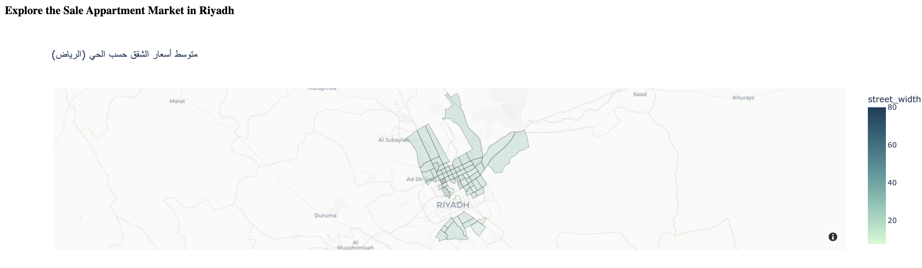

Utilizing analytics tools and machine learning reduces search time by up to 50%
Goal
Approach
Example
Gain insight into market
Develop analytical dashboard
Great deal! This apartment is listed at 10% lower than its fair value.
Narrow down option
Price Fairness Meter

Slide 5
Executive summary
Motivation & goals
Deliverables
Data set
Analytics Dashboard
Deal Fairness Indicator
Next steps
Challenges & limitations
Future improvements

Slide 6






We gathered data of the majority of apartments currently listed for sale in Riyadh, amounting to 7000+ apartments
Attributes
Conclusions
Floor Plan
# of Bedrooms
# of Bathrooms
# of Living/Guest rooms
Has Kintchen
# Bedrooms
# Bathrooms
23+ gathered and engineered attributes for each apartment
Some attributes suffer greater levels of inaccuracy
Data was gathered by scraping Aqar.com
Area
Area (sqr. m)
Dimensions
Length:Width Ratio
Shape Regularity
Location
District
Street Width
Street Direction
Latitude & Longitude
Features
Installed Kitchen
Furnished
Installed AC
Building
Age
Apartment Floor
Online Post
Post ID
Advertisor ID
Advertisor Type (owner)
Advertisor Rating
Time on Market
Last Update

Slide 7
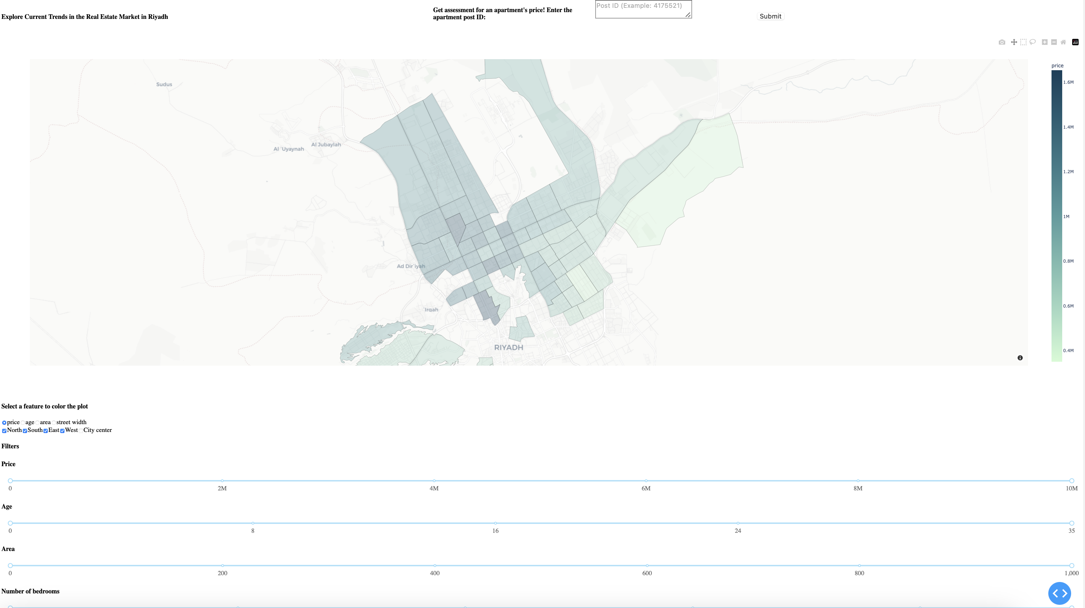
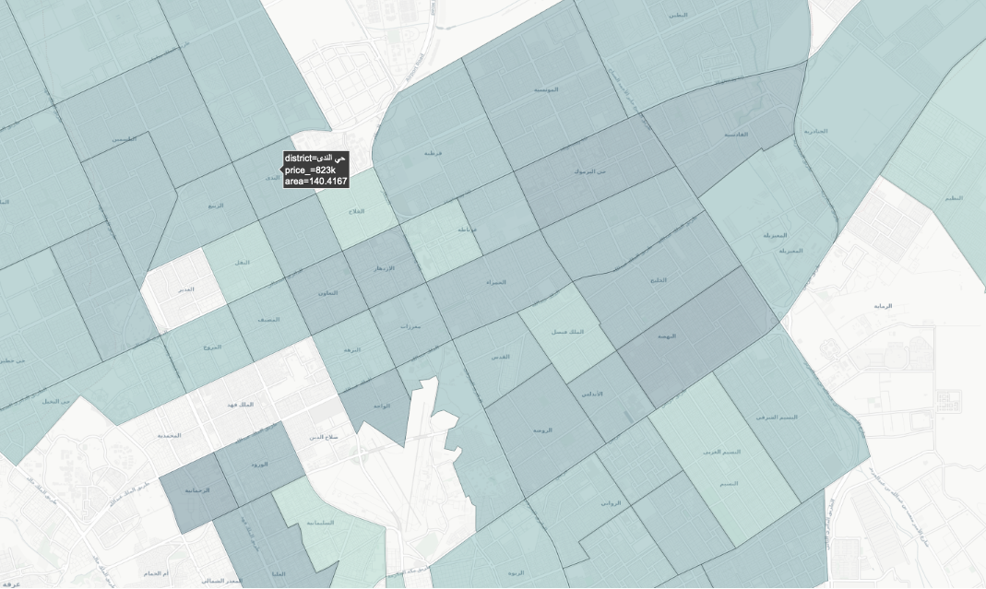
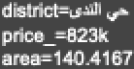
Providing a district-level analytical dashboard enables home-buyers to quickly find the expected price of the apartment they are looking for
Aqar only offers filtering search results by price and location, which results in thousands of results; we enable our users to target their efforts by filtering for exactly what they want

Slide 8
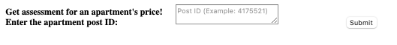



We developed a Deal Fairness Meter to help users determine if an apartment they are interested in has a reasonable asking price
Approach to generate Deal Fairness Score
Notes
Find Online Post
Search Aqar.com to find the apartment with the given Post ID
Collect the apartment data and prepare it to enter the machine learning model
Our estimate for a “reasonable price” is based on the 23+ attributes of each apartment
7000+ apartments were used to train the machine learning model
The model’s predictions are accurate, with an average prediction error of ~20k SAR
The tool is currently limited to searching for listings on Aqar.com
Predict Price
Use the data as input into the ML model
Output is our estimate of a reasonable price
Compare Prices
Compare our generated reasonable price with actual asking price
Report: {Terrible Deal, Bad Deal, Fair Deal, Good Deal, Great Deal}
Enable Filtering
Additional step: run all apartments in the database through the Deal Fairness Meter
Allow users to filter for only Good and Great Deals
The Deal Fairness Meter is used for two tasks:
Enable users to access outside advice for an apartment they found online which they are interested in
Enable users to quickly filter our database for only the good deals, then download that list to find those listings on Aqar.com

Slide 9
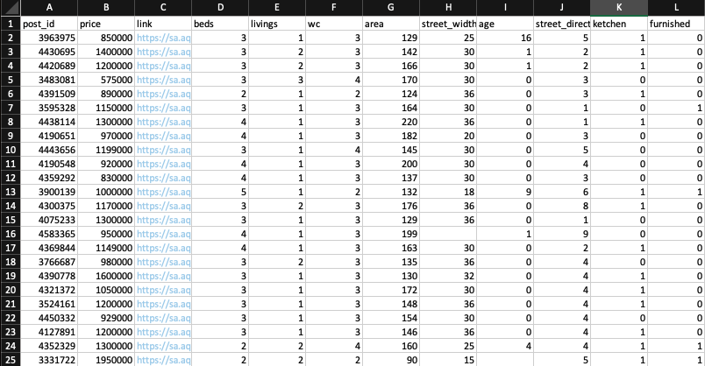
After narrowing down the search results to a managable number, the user can download a list of candidate apartments for further analysis

Slide 10
With our filteration system and Deal Fairness Scores, we can narrow down search results by more than 90%, saving users 50+ hours of search
7k apart-ments
Value created
On average, home-buyers spend 100 hours of search
If our services saves 50% of that search time, then we are saving our users 50 hours of work
Assuming an hour is worth 5 SAR (certainly an under-estimate), then we are creating 250 SAR of value for each customer!
Search results in Aqar.com
>200
Search results when using our additional filters
>100
Search results when filtering for GOOD and GREAT deals

Slide 11
Executive summary
Motivation & goals
Deliverables
Data set
Analytics Dashboard
Deal Fairness Indicator
Next steps
Challenges & limitations
Future improvements

Slide 12



We recognize the huge value generated by this tool, and we recognize its many aspects that need further development
Limitations
Future developments
Accessability
Our database and Deal Fairness Meter tool are limited to apartments listed in Aqar.com
Develop data-scraping scripts for other platforms
Data Quality
Some listings contain false information about their properities, which hinders our ability to generate accurate predictions
Develop machine learning models that can perform well desbite missing data
Biased Predictions
Our prediction model performs particularly poorly on some types of apartments (e.g., high-end luxury apartments)
Develop multiple machine learning models for the different price ranges

Slide 13
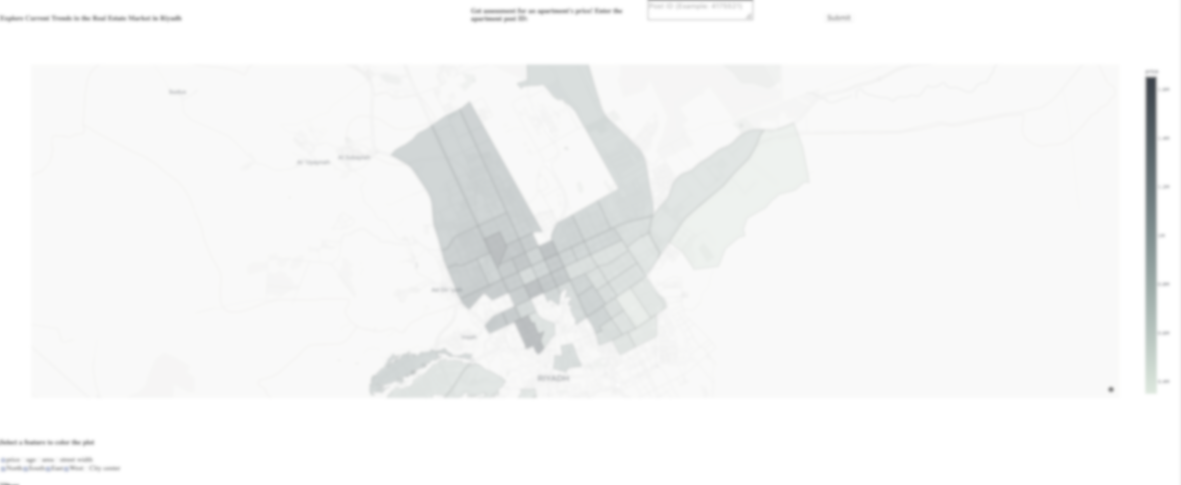
THANK YOU!
Presented by: Mohammed Alsalamah

